Slide 1
BRDHD Allergy First Aid
For Child Care Providers

Slide 2
Allergic Reactions
An allergy can happen at any time, whether you have had previous exposure to the allergen or not.
Examples:
Medications
Insect stings
Food
Latex
Aromas
Exercise

Slide 3
Medications
Penicillin
Sulfa
Codeine
Dye
Flavoring
Aspirin
Non-steroidal anti-inflammatory drugs
Ibuprofen, naproxen, etc.

Slide 4
Insect Stings/ Bug Bites
Normal Reaction to Allergen
Abnormal Reaction to Allergen
Red area
Pain
Itching
Small amount of swelling at site
Large amount of swelling at site or away from the site (lips, face, eyes)
Hives
Difficulty breathing, swallowing, talking
Chest pain
Severe headache

Slide 5
Food Allergies
Accounts for 35-55% of all cases of anaphylaxis
Most common food allergens:
Peanut
Tree nut (walnut, hazelnut, etc.)
Fish
Milk
Egg
Gluten (ingested or touched)
Tempura paint
Play dough
Using food as craft supplies (pasta and beans)
Other common food allergens
Soy
Shellfish
Apricot
Banana
Cherry
Kiwi
Papaya
Peach
Pineapple
Plum
Strawberry ***common in Hispanics***

Slide 6
Latex
Latex- containing items:
Balloons
Medical gloves
Rubber bands
Headphones and ear buds (foam under protective coating)
Pen/ pencil grips
Bandaids
Sports ball (foam under protective coating or where you insert air)
Banana
Avacodo

Slide 7
Aromas
Chemicals
Perfumes
Fragrance Sprays
Candles
This reaction is worse for persons with asthma.
Throat spasms instead of swells.

Slide 8
Exercise
Increased histamine production during vigorous physical activity like jogging, tennis, dancing, or bicycling.
Typically causes hives.
More common in person’s with asthma.

Slide 9
Anaphylaxis
A life-threatening emergency that without treatment, it is fatal!
Signs may appear minutes or hours after exposure and progress rapidly
Difficulty breathing and/ or higher-pitched sounds with breathing
Difficulty swallowing or hoarseness
Swelling of eyes, lips, face or tongue
Rapid or weak pulse
Dizziness or fainting
Loss of consciousness
Abdominal pain, nausea or vomiting
Widespread hives or hives on the torso and neck
Flushed skin
Sweating
Sense of doom/ feeling like you are going to die
Incontinence

Slide 10
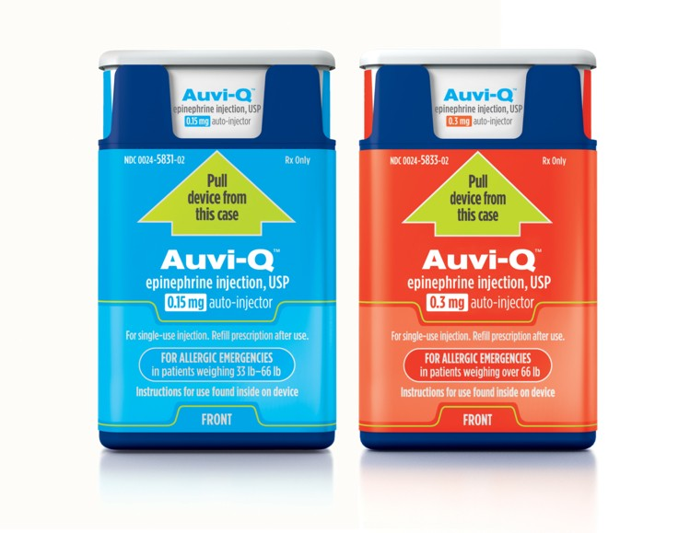
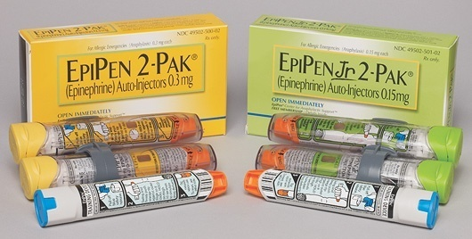
ACT FAST!
The faster the onset of signs from exposure, the higher risk for severe symptoms and death
One or more signs of anaphylaxis will require immediate injection of epinephrine
Call 9-1-1

Slide 11
Anaphylaxis Treatment Protocol
Do not move the person.
Have the person lie down and elevate their feet.
Get the person’s prescribed epinephrine auto-injector. If they do NOT have one, you CANNOT use another person’s medication. If you have stock epinephrine auto-injectors, get the appropriate dosage.
Administer the epinephrine auto-injector.

Slide 12
Note the time when the auto-injector was used.
Do not leave the person unattended.
If the reaction is from an insect sting, remove the stinger if present.
If the person is still having symptoms, administer a second dose of epinephrine 15 minutes from the initial dose.

Slide 13
Constricts Blood Vessels – Raises Blood Pressure
Epinephrine
Opens lower airways
Reduces Swelling

Slide 14
Side Effects of Epinephrine
Rapid heart rate
Feeling of nervousness
Tremors
Nausea and/or vomiting
Sweating
Headache
Pale skin
Rapid breathing
The effects may last between 5 and 20 minutes

Slide 15
How to Administer Epinephrine
Make sure you are holding the epinephrine correctly, keeping fingers away from the tip of the device.
Remove the safety cap from the injector.
Position the device against the thigh.
You do NOT have to undress the person.
For Epipens, swing the pen into the thigh until you cause a click. For Auvi-Q, Push the device down hard enough to cause a click.
Hold the device firmly against the thigh for 3 seconds for epipens and 5 seconds for Auvi-Q during medication administration.

