Slide 1
Keeping Children Safe in Early Care and Education Settings
Introduction to Safety and Injury Prevention in Early Care and Education Settings

Slide 2
Keeping Children Safe From Injuries in Early Care and Education Settings
Welcome
Date
Location
PRESENTER INFORMATION HERE
Notes:
Welcome everyone and thank participants for coming.
Introduce yourself.
Connect with participants and get an idea of who they are.
If the group is small enough, ask participants to introduce themselves, tell where they work, and describe their type of early care and education facility and their role.
Alternatively, ask participants to raise their hands if they are center directors, early care and education workers, Head Start providers, family child care providers, parents, grandparents, etc.

Slide 3
Learning Objectives
State most common injuries in early care and education
Recognize safety hazards
Prevent most common injuries
Know requirements for injury reporting
Partner effectively with community
Notes:
Review learning objectives with participants.
By the end of today’s lecture, you will be able to:
State the most common injuries in the early care and education setting
Recognize safety hazards
Prevent the most common injuries
Know the requirements for reporting an injury
Partner effectively within your community
Design note: There is no participant manual. The slides will be used to create the participant handout (without speaker notes). The learning objectives need to be on the screen so participants can refer to them.

Slide 4
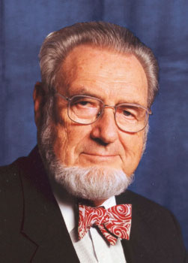
“If a disease were killing our children in the proportions that injuries are, people would be outraged and demand that this killer be stopped.”
C. Everett Koop, MD
Former US Surgeon General
Notes:
C. Everett Koop helped raise injury prevention as a public health issue.

Slide 5
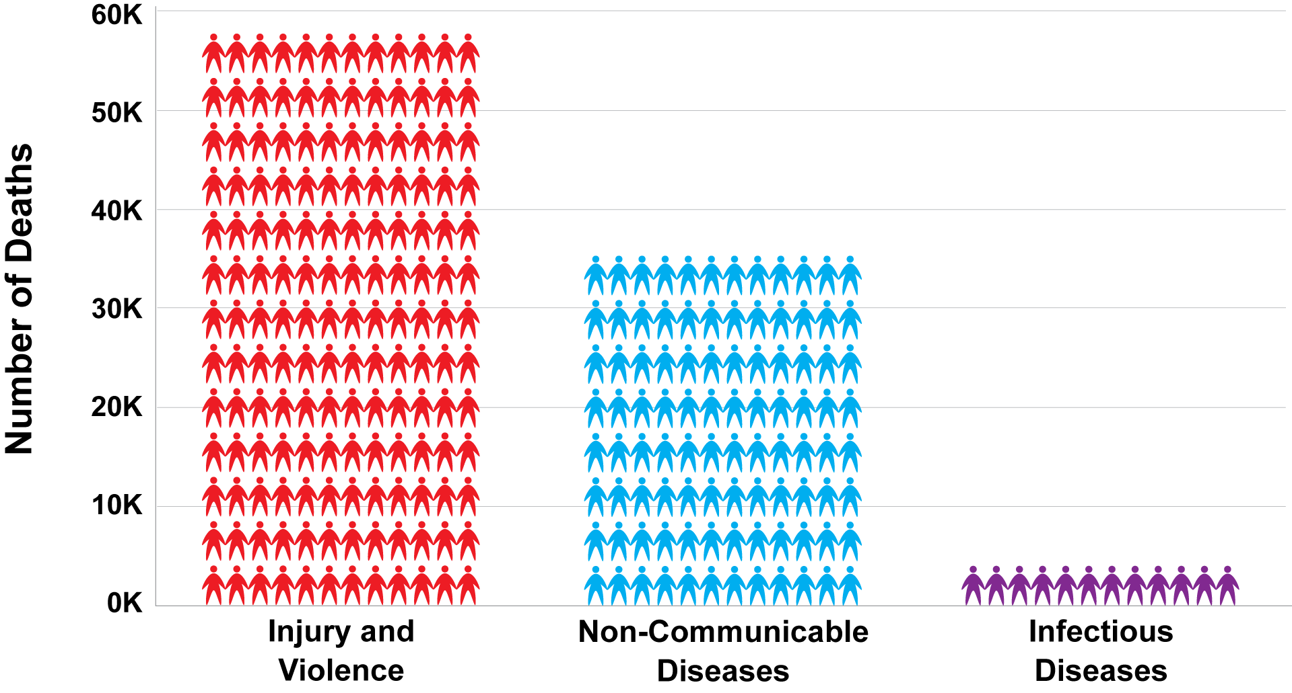
Injury Deaths Compared With Other Leading Causes of Death for People Ages 1 – 44, United States, 2013
http://www.cdc.gov/injury/overview/leading_cod.html
Notes:
When it comes to public health, many people focus on diseases. But the fact is that more people die each year from injury and violence than from diseases. In fact, the number one cause of death and disability among children alone in the US is from injuries. Most injuries are preventable AND predictable.
Source
Centers for Disease Control and Prevention (CDC) Injury Prevention and Control) - http://www.cdc.gov/injury/overview/leading_cod.html

Slide 6
Injury
Notes:
More than 9,000 children die each year from injuries, which is equal to 150 school buses all loaded with children.
However, injury deaths are only part of the tragic story. Each year, millions of children are injured and have to live with these injuries for a period of time; however, sometimes their injuries have a lifelong effect.
With a fatal injury, family, friends, coworkers, employers, and other members of the child’s community feel the loss. With a nonfatal injury, family members must often care for the injured child, which can cause stress, time away from work, and lost income.
Injuries to children can result in major expenses, including medical costs for the injured child and loss of wages for the parent/caregiver.
The consequences of these fatal and nonfatal injuries to children have a physical and emotional cost to the individual and our society. An injury affects more than just the injured child—it affects many others involved in the child’s life. The community also feels the cost burden of child injuries, as does the state and the nation.
For children, even minor injuries causes pain and may limit their activities. Major injuries may involve hospitalizations, ER visits, and multiple doctors’ visits. Sometimes the injury can lead to one or more of the following: physical limitations, stress, depression, constant pain, and a major change in their lifestyle or quality of life.
Source
Centers for Disease Control and Prevention, Vital Signs 2012. (http://www.cdc.gov/VitalSigns/pdf/2012-04-vitalsigns.pdf)

Slide 7
Injuries Among Children
Leading cause of death and disability
10% of injuries in preschoolers happen in an early care and education settings
Not accidents
Preventable and predictable
Notes:
Injuries are the main cause of death and disability among children in the United States. Ten percent of those injuries in young (preschool) children happens in the early care and education setting.
Injuries are NOT accidents as that implies or suggests that they occur randomly and could not be prevented. But we know that is not true, because we know that most common injuries among children are preventable and predictable.
Source
Hashikawa AN, Newton MF, Cunningham RM, Stevens MW. Unintentional injuries in child care centers in the United States: A systematic review. Journal of Child Health Care. 2015 Mar;19(1):93-105. doi: 10.1177/1367493513501020. Epub 2013 Oct 3.

Slide 8
Safe Kids USA
Notes:
Show the video. Imagine a World Where Every Kid is a Safe Kid – Help each child reach their full potential by reducing preventable injuries.
http://www.safekids.org/video/imagine-world-where-every-kid-safe-kid

Slide 9
The Early Care and Education Provider
Relationship with family and child
Model safety for children and families
Notes:
Why is your role as a early care and education provider so important?
Children spend a lot of time in the early care and education setting. In fact, some children spend more awake hours there than they do at home. Children depend on caregivers to provide a safe environment away from home.
As a provider, and because of your relationship with the family and child, you are the perfect person to focus on safety. You have the chance to not only keep the children safe, but to find ways to teach them about how they can prevent injuries. This can be done by modeling and explaining safe behaviors in a way that is appropriate for the age and developmental level of the children in your care.
Explain to participants the importance of role modeling. Adults often underestimate their impact with role modeling. Children will follow your example. Always practice safe behavior. The effectiveness of health and safety education is enhanced when shared between the caregiver/teacher and the parents/guardians.
Source
CFOC Standard 2.4.1.2 – Staff modeling of healthy and safe behavior and health and safety education activities. (http://cfoc.nrckids.org/StandardView/2.4.1.2)

Slide 10
Caring For Our Children Standards
Caring for Our Children: National Health and Safety Performance Standards—Guidelines for Early Care and Education Programs
3rd edition
Available at http://cfoc.nrckids.org
(free download and purchase options)
Notes:
Caring for Our Children contains standards for injury prevention and safety practices.

Slide 11
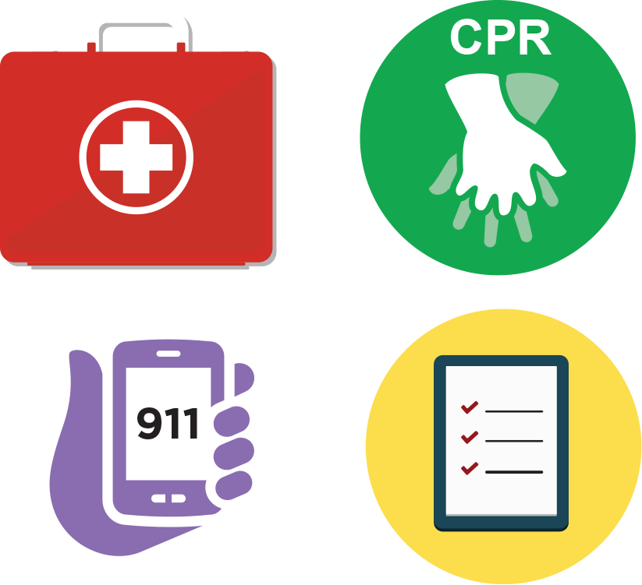
Injuries
Pediatric first aid kit
Pediatric CPR and first aid training
Communication device for emergencies (911)
Document and notify parents and state licensing agency
Report serious injuries to appropriate authorities
Notes:
Pediatric First Aid kits should be stocked and available in each location where children are cared for. This includes a transportable first aid kit that can go with the children for a walk or in a vehicle.
Pediatric First Aid and CPR training
You are most likely to need first aid skills, therefore, all staff members that have contact with children should be current on training for first aid.
At least 1 staff member currently certified in CPR should be present at all times.
Communication device
Emergencies can happen quickly. Each staff member should have a way to call for help. This is especially important when children are taken away from the facility to a playground, for a walk, or on a field trip.
Document and notify parents
In the event of an injury a report should be completed and filed. Parents should be notified immediately of an injury or illness of their child.
Require that child care providers report any serious injuries or deaths of children occurring in child care to a designated state, territorial, or tribal entity.
Source
Child Care and Development Fund, Section 98.42 – Enforcement of licensing and health and safety requirements. (b)(4)

Slide 12
CASE PRESENTATION

Slide 13
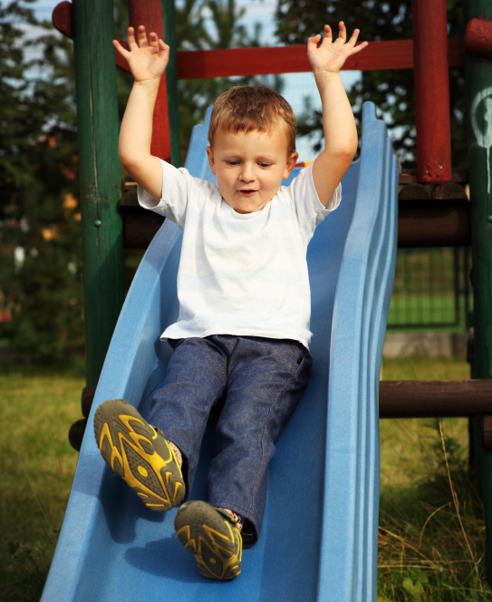
Case Presentation: Bobby
3-year-old boy on playground
Phone rings
You turn away and answer it
Bobby starts crying
He fell off slide onto pavement
Notes:
Present this scenario to your participants.
Bobby, a 3-year-old boy in your center, is playing outside on the playground when the phone rings. You turn away from him to answer it. When your back is turned, you suddenly hear Bobby crying. When you find him, you realize that he fell off the slide and landed on the pavement below.

Slide 14
Case Presentation: Bobby
What do you do next?
What could have prevented this?
How should you document and report any injuries?
Notes:
Ask the participants these questions and have them provide responses.

Slide 15
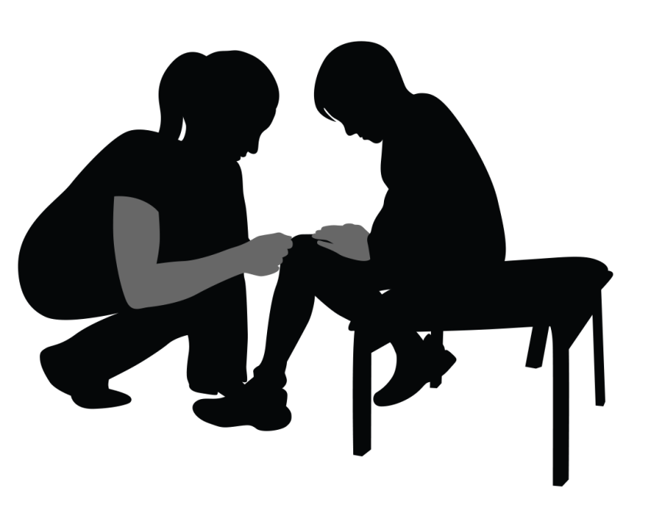
Case Presentation: Bobby
What do you do next?
Make sure child is alert
Check for injuries
Give first aid, if needed
Notes:
What do you do next?
Check to make sure he is alert
Evaluate for injuries
Get the first aid kit, if needed, for cuts or scrapes

Slide 16
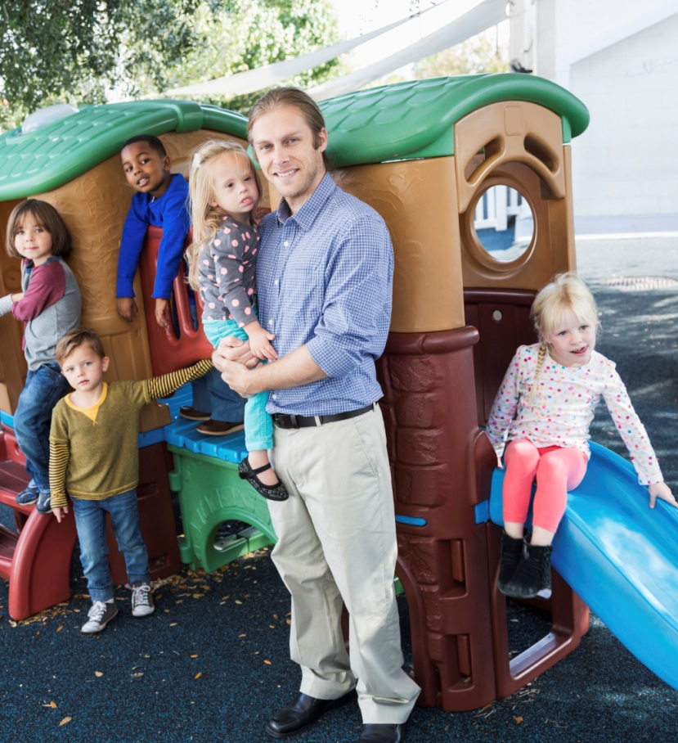
Case Presentation: Bobby
Preventing future incidents and injuries
Ensure adequate supervision
Limit distractions (eg, cell phones)
Never leave children unattended
Make sure shock-absorbing surface is under equipment
Notes:
What could you have done to prevent this?
Have other adults around to supervise the children
There is nothing that can replace adult supervision. When adults are supervising children, they should always pay attention to what the children are doing.
Limit distractions
Never leave the child unattended or turn your back on them while you are supervising them
Make sure that all playground equipment is on shock-absorbing surfaces

Slide 17
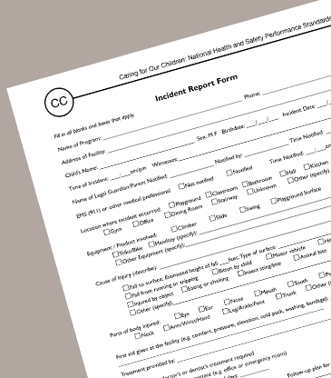
Case Presentation: Bobby
Reporting and Documentation
Use a standard reporting form and provide details
Call parents
Discuss how to prevent this from happening again
Notes:
How should you document and report any injuries?
Use the Standard reporting form to document the incident and any injuries
Call the parents to inform them of the incident and any injuries
Brainstorm with other staff to discuss how to prevent this from happening again
For Head Start Programs: You can also use the CFOC Incident Report Form, Appendix CC, which sometimes works better for early care and education programs, as it has language that aligns with injuries in early care and education programs.
Injury reports are important because they can be used to look for patterns of injuries and figure out the causes, so that the same injuries don‘t happen over and over again.
Sources
CFOC Appendix CC – Incident Report Form. (http://cfoc.nrckids.org/WebFiles/AppendicesUpload/AppendixCC.pdf)
CFOC Appendix DD – Child Injury Report Form for Indoor and Outdoor Injuries. (http://cfoc.nrckids.org/WebFiles/AppendicesUpload/AppendixDD.pdf)

Slide 18
Pre Quiz
What is the most common injury among children age 0-5?
Broken bones
Falls
Choking
burns
Notes:
At the beginning of the presentation, 5 questions were posed that you were asked to think about during the talk. We will now revisit these questions, answer them, and discuss them. Please refer to the standards in Caring for Our Children for more information.
Source
Caring for Our Children Standards. (http://cfoc.nrckids.org/)

Slide 19
Pre Quiz
What is the most common preventable cause of death for children ages 1-4?
Burns
Choking
Drowning
Bicycle accidents
Getting hit by a car

Slide 20
Pre Quiz
Is there a requirement to report injuries?
Yes
No

Slide 21
Pre Quiz
Where do the majority of infant drowning deaths occur?
Pools
Ponds/Lakes
Falling off a boat
Bathtubs/Buckets

Slide 22
Pre Quiz
What object is associated with the highest rate of death from choking?
Grapes
Hotdogs
Latex Balloons
Marbles
Coins

Slide 23
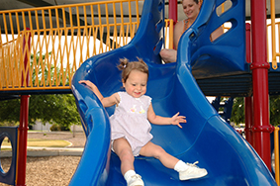
Preventable Injury
Preventable Injuries are:
Unintentional (not on purpose)
Not accidents
More common among children
Notes:
Let’s talk about preventable injuries.
A preventable injury is unintentional (not something that was done on purpose).
It is something that can be avoided by taking steps to ensure that the child’s environment is safe and that adult supervision is in place at all times.
Children are more likely to get injured because of their size, their growth and developmental stage, inexperience, and curiosity.
Sources
Centers for Disease Control and Prevention (www.cdc.gov)
Stepping Stones to Caring for Our Children, 3rd edition. Child Ratio Chart. (http://nrckids.org/index.cfm/products/stepping-stones-to-caring-for-our-children-3rd-edition-ss3/stepping-stones-to-caring-for-our-children-3rd-edition-ss3/)

Slide 24
Preventable Injury
These injuries can be prevented by:
Creating/maintaining safe areas
Providing adult supervision at all times
Keeping maximum child:staff ratio
Notes:
Injuries can be prevented by:
Making sure their environment is safe according to safety standards
Having safety precautions in place
Making sure there is adult supervision at all times
Maintain maximum child:staff ratio
Source
CFOC Standard 1.1.1.2 - Ratios for large family child care homes and centers. (http://cfoc.nrckids.org/StandardView.cfm?StdNum=1.1.1.2&=+)

Slide 25
Types of Preventable Injuries
Falls from playground equipment
Ingestions/Poisonings
Drownings
Burns
Motor vehicle accidents
Suffocation
Injuries from wheeled toys
Notes:
Here are some examples of preventable injuries, both in early care and education settings, as well as other places.

Slide 26
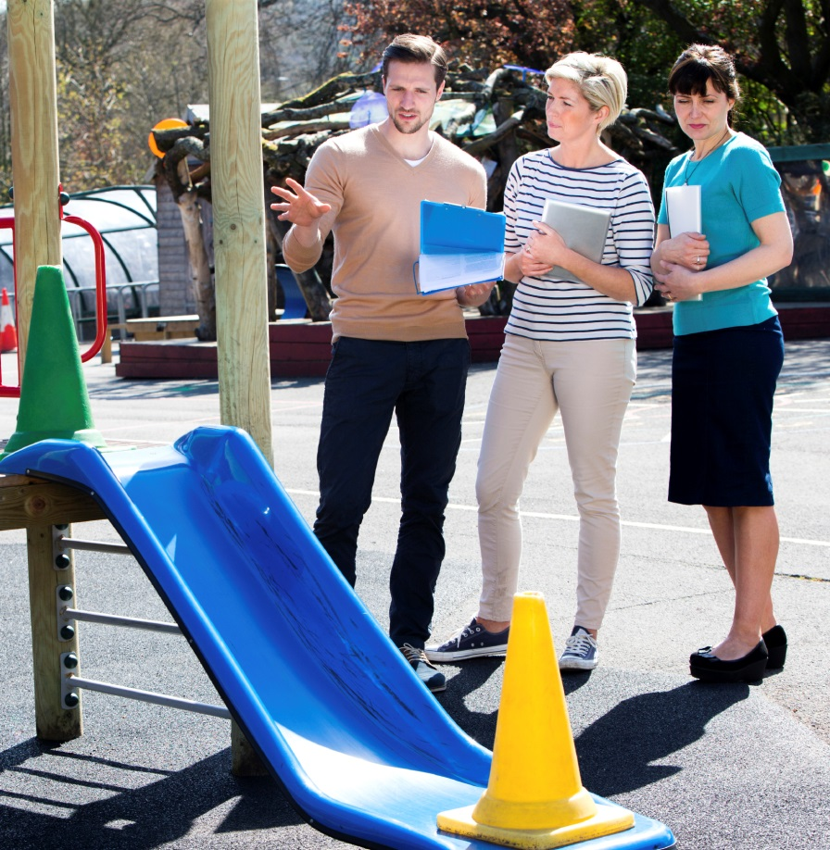
Causes of Nonfatal Injuries in Young Children
Most common nonfatal injuries seen in the ER in young children
Falls
50% of injuries in children
<1 year
Struck by or against an object
Animal bites/insect stings
Notes:
Injuries due to falls were the leading cause of nonfatal injury.
Each year, approximately 2.8 million children had an initial emergency department visit for injuries from a fall.
For children less than 1 year of age, falls accounted for over 50% of nonfatal injuries.
The majority of nonfatal injuries are from five causes.
Falls was the leading cause of nonfatal injury for all age groups less than 15.
For children ages 0 to 9, the next two leading causes were being stuck by or against an object and animal bites or insect stings.
For children 10 to 14 years of age, the next leading causes were being struck by or against an object and overexertion.
For children 15 to 19 years of age, the three leading causes of nonfatal injuries were being struck by or against an object, falls, and motor vehicle occupant injuries.
Source
CDC Childhood Injury Report. (http://www.cdc.gov/safechild/Child_Injury_Data.html)

Slide 27
Causes of Fatal Injuries in Children
Main cause of death for children
Ages 1-4: Drowning
Under age 1: Suffocation (while sleeping) or strangulation
Boys vs. Girls
Boys are twice as likely to have an injury-related death than girls
Notes:
The number one cause of injury-related death for children ages 1-4 is drowning
Leading cause of injury-related death for children under the age of 1 is unintended suffocation (mostly while sleeping) or accidental strangulation.
Injury-related deaths are more likely to occur in boys (twice as likely as girls)
Source
CDC Childhood Injury Report. (http://www.cdc.gov/safechild/Child_Injury_Data.html)

Slide 28
RECOGNIZING and preventing SAFETY HAZARDS

Slide 29
Safety/Injury Hazards
General Physical Environment
Elevated surfaces (steps, stairs, stage)
Strangulation (straps, strings)
Furniture (can tip over)
Sharp corners or points
Electrical outlets
Protruding nails/bolts/other small objects
Unsafe sleeping environments
Notes:
Ask participants to identify possible safety/injury hazards in the physical early care and education environment
Potential hazards in early care and education settings and home settings:
Stairs, steps or stage (children can fall down them if not properly gated)
Strings or straps (can cause strangulation if it gets around the child’s neck)
Tip-over hazards (bookshelves, chairs)
Sharp corners or points
Electrical outlets that are not properly covered
Protruding nails/bolts and other small objects that may become detached
Unsafe sleeping environments

Slide 30
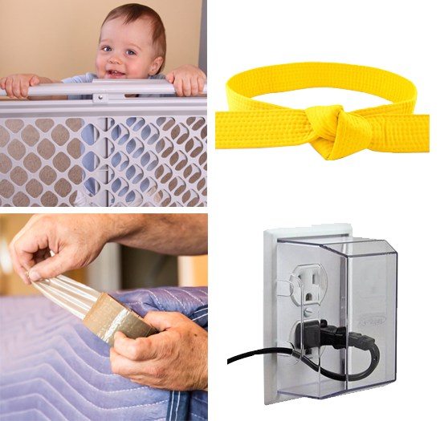
Safety/Injury Hazards
Prevention of these hazards
Put gates at stairways
Remove straps/strings
Secure furniture
Cover sharp corners
Install tamper-resistant electrical outlets/outlet covers
Notes:
Discuss strategies to prevent and minimize injuries from these hazards.
Source
Stepping Stones to Caring for Our Children, 3rd edition. (http://nrckids.org/index.cfm/products/stepping-stones-to-caring-for-our-children-3rd-edition-ss3/stepping-stones-to-caring-for-our-children-3rd-edition-ss3/)

Slide 31
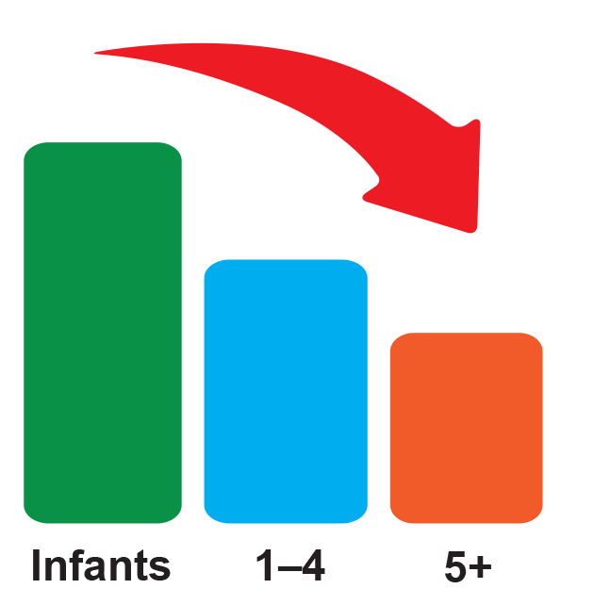
Choking
Choking rates highest among infants
140 per 100,000
Risk decreases with age
90% of choking in children under 4 years of age
Objects less than 1.5 inches in diameter have higher choking risk
Notes:
Choking rates are highest among infants (140 per 100,000) and risk decreases with age
Almost 90% of fatal choking occurs in children younger than 4 years of age
Objects that are less than 1.5 inches in diameter (or 1.75 inches for small spherical objects) are higher risk for choking
Just because a toy is on the market does not guarantee its safety
Source American Academy of Pediatrics, Committee on Injury, Violence, and Poison Prevention policy statement. Prevention of choking among children. http://pediatrics.aappublications.org/content/125/3/601

Slide 32
Common Choking Hazards
Latex Balloons
Leading cause of choking death
Round or Cylinder shapes
High Risk Foods
Hot dogs, hard candy, peanuts, seeds, whole grapes, popcorn, marshmallows, gum
Notes:
The most common safety hazards for children are:
Latex balloons – lead cause of choking death; conform to airway to create a seal that blocks breathing
Round or cylinder shapes – if they are small enough, they can fit snugly in the throat and block airway
Foods – the most common foods that children choke on include hotdogs (most common among fatal choking), nuts, seeds, whole grapes, raw carrots, popcorn, marshmallows, gum, peanut butter, and sausages.
Source American Academy of Pediatrics, Committee on Injury, Violence, and Poison Prevention policy statement. Prevention of choking among children. http://pediatrics.aappublications.org/content/125/3/601

Slide 33
Choking Signs
Inhaled objects or food
Coughing
Drooling
Trouble breathing/noisy breathing
Turning blue
Ingested objects or food
Drooling
Vomiting
Abdominal pain/refusal to eat
Notes:
Early care and education providers need to know the signs for choking, both for objects and food that are either inhaled or ingested. Keep in mind that a choking child may not make any signs, so it’s important to watch the children while they are eating to look for potential sudden signs of distress. Supervision is key to choking prevention, especially for younger children who are learning to feed themselves.
Source
CFOC Standard 4.5.0.6 - Adult supervision of children who are learning to feed themselves. (http://cfoc.nrckids.org/StandardView.cfm?StdNum=4.5.0.6&=+)

Slide 34
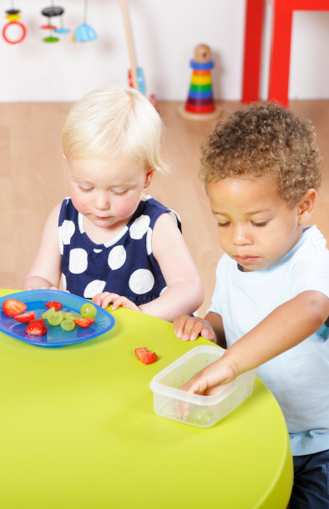
Choking Prevention
Cut food in small pieces
¼ inch or smaller (infants)
½ inch or smaller (toddlers)
Avoid high risk foods (children under 5)
Children should be seated while eating (no playing/running)
Supervise children
Check toys for small, loose pieces
Keep magnets/batteries away from children
Notes:
Early care and education providers can take precautions to prevent potential choking incidents.
Cut food in small pieces
¼ inch or smaller (infants)
½ inch or smaller (toddlers)
For children with teeth, food selection should be different. If the child has his/her molars, it’s a good indication that the child will be able to chew harder foods
Avoid high risk foods (children under 5)
Make sure children are seated while eating
Children should never be playing or running while eating
Supervise children
Check toys for small, loose pieces
Keep magnets and batteries away from children
Sources
CFOC Standard 4.5.0.10 - Foods that are choking hazards. (http://cfoc.nrckids.org/StandardView.cfm?StdNum=4.5.0.10&=+)
Stepping Stones to Caring for Our Children, 3rd edition. (http://nrckids.org/index.cfm/products/stepping-stones-to-caring-for-our-children-3rd-edition-ss3/stepping-stones-to-caring-for-our-children-3rd-edition-ss3/)

Slide 35
Most Common Fall/Crush Hazards
Televisions
Bookcases
Furniture and dressers
Stairs with poorly installed gates
Unlocked windows
Heavy objects on shelves
Notes:
The most common hazards that can result in falls and children being crushed include:
Televisions
Bookcases
Furniture and dressers
Stairs with poorly installed gates
Unlocked windows
Heavy objects on shelves

Slide 36
Fall/Crush Hazard - Televisions
Every 3 weeks, a child dies from a television tipping over
Over past 10 years, a child visited the ER every 45 minutes for injury related to a TV tipping over
36-inch TV falling 3 feet = 1-year-old falling 10 stories
Notes:
Source Safe Kids Worldwide:
(http://www.safekids.org/press-release/one-child-dies-every-three-weeks-tv-tipping-over)
(http://www.safekids.org/tv-and-furniture-tip-overs-0#sthash.jn6wl3zr.dpuf)

Slide 37
Injuries from Falls/Crushes
Broken bones
Skull/brain injuries (can be life threatening)
Concussions

Slide 38
Preventing Fall/Crush Hazards
Secure televisions (to wall or on stable table)
Secure heavy furniture (bookshelves) with brackets, braces, or wall straps
Keep heavier items on lower shelves
Don’t place items high – children will want to climb for them (eg, toys)
Notes:
There are many precautions that should be taken in the early care and education setting to prevent falls or children being crushed by object.
Put televisions on low, stable furniture (if it’s a tube TV) or on wall (if it’s a flat screen TV) and assess stability
Use brackets, braces, or wall straps to secure heavy furniture to the wall (eg, bookshelves)
Keep heavier items on lower shelves
Don’t place items (such as toys) too high, as children will want to climb for them
Source
Safe Kids Worldwide. TV and furniture tip-over prevention tips. (http://www.safekids.org/sites/default/files/documents/tv_and_furniture_safety_tips_v2.pdf)

Slide 39
Preventing Fall/Crush Hazards
Keep windows locked
Use approved safety gates (top and bottom of stairs)
Strap babies and young children in high chairs, strollers, and swings
Never leave children unattended
Adult supervision
Notes:
Make sure that windows are locked; if they are open, install window guards to prevent falls from windows
Screens are meant to keep bugs out, not children in!
Use approved safety gates (top and bottom of stairs) and follow manufacturer’s instructions
Strap babies and young children in high chairs, strollers, and swings
Never leave children unattended
Don’t leave children in boppy seats, car seats, or on counters
Adult supervision is crucial

Slide 40
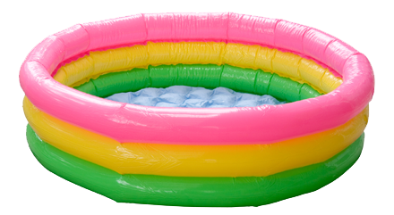
Water Safety
Bathtubs or Large Buckets
Majority of infant drowning deaths
Swimming Pools
Most common place for drownings of 1-4 year olds
Notes:
The majority of infant drowning deaths occur in bathtubs or large buckets
The most common place for drownings of 1-4 year olds is a swimming pool and smaller “kiddie” pools
Source
Safe Kids Worldwide. Water Safety. (http://www.safekids.org/water-safety#)

Slide 41
Drowning Prevention
ALWAYS supervise children
Make sure pools are fenced in with gates/latches
Avoid distractions (eg, reading, talking)
Be aware of hazards (even in shallow water)
Close bathroom doors and toilet lids
Never leave a child alone in a bathtub
Notes:
ALWAYS supervise children in/around water
Make sure pools are fenced in with at least a 4 foot high fence with self-closing and self-latching gates
Avoid distractions (eg, reading, talking on phone)
Be aware of potential water hazards (even shallow water)
Close bathroom doors and toilet lids and drain tub when done
Never leave a child alone in a bathtub
Sources
Safe Kids Worldwide. Water Safety. (http://www.safekids.org/water-safety#)
Stepping Stones to Caring for Our Children, 3rd edition. (http://nrckids.org/index.cfm/products/stepping-stones-to-caring-for-our-children-3rd-edition-ss3/stepping-stones-to-caring-for-our-children-3rd-edition-ss3/)

Slide 42
INJURY TRAINING FOR EARLY CARE AND EDUCATION PROVIDERS

Slide 43
Training Requirements for Providers
Early Care and Education Providers must have pediatric first aid and CPR training
Valid certificate is required
Notes:
Directors of early care and education centers should have documentation that their staff have completed training in first aid and CPR.
Satisfactory completion of the training should be noted by a certificate.
Source Stepping Stones to Caring for Our Children, 3rd edition. Standard 1.4.3.1 – First aid and CPR training for staff. (http://nrckids.org/default/assets/File/Products/Stepping%20Stones/Stepping%20Stones%203rd%20Ed%20updated%208-15.pdf)

Slide 44
Training Requirements for Providers
Early Care and Education Providers must:
Have pre-service training in health management
recognize signs of illness
Know about infectious disease prevention
Know about safety/injury hazards
Have knowledge about safe sleep practices (infants)
Reducing SIDS risk
Preventing shaken baby syndrome
Notes:
The next couple of slides can be important training requirements not covered in this lecture but can be found as training elsewhere by AAP:
1. Infectious Disease Training
2. Medication Administration
3. Reducing SIDS risk
4. Shaken Baby Syndrome
It is important that early care and education providers have pre-service training in health management in the early care setting.
They need to be able to:
Recognize the signs of illness
Have knowledge about infectious disease prevention
Understand what injury/safety hazards there are in the center and how to prevent potential injuries
For infants, it’s important that providers know about safe sleep practices (on the back), which reduces the risk of Sudden Infant Death Syndrome (SIDS)
They should also be aware of how to prevent shaken baby syndrome/abusive head trauma, including how to cope with a crying infant
Early care and education providers should also:
Have knowledge of normal child development and know the indicators when a child is not developing typically
Know how to appropriately respond to a child’s needs
Understand the importance of the adult-child relationship, as it nurtures the child’s brain development and builds important connections
Have medication administration training

Slide 45
REPORTING INJURIES

Slide 46
Legal Reporting/Documentation Requirements
Notify parent/guardian immediately if:
Injury or illness required first aid or medical attention
Child is lost or missing, fire, or closure of the center
Document notification of parent/guardian and law enforcement
Know and follow state notification regulations
Notes:
After calling 911, legal requirements for reporting injuries in the early care and education setting require notification of parents/guardians immediately if:
The injury or illness required first aid or professional medical attention
There is any other significant event that effects the health and safety of their child (eg, child is lost or missing, a fire or other damage, or closure of the center)
Typically best to notify parent if any injury (even if minor) – sometimes bruises, swelling can develop later and parents may wonder what happened
Document that the child’s parent/guardian was notified immediately for any of the cases just mentioned
Documentation should also occur when law enforcement is notified
Follow state regulations for notification requirements to state agencies (eg, licensing agency and local/state health department)

Slide 47
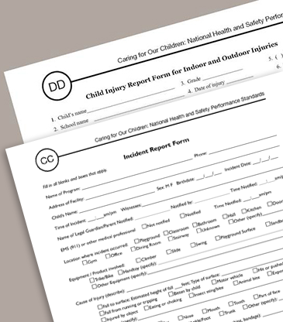
Documentation Requirements
An incident report form should be completed (Appendices CC and DD in Caring for Our Children)
Injuries that need to be reported include:
Child maltreatment
Bites
Falls
Ingestions
Notes:
Use incident reporting form to document injuries
Injuries that need to be reported include:
Child maltreatment (physical, sexual, emotional, and neglect/abuse)
Bites (continuous, painful, break skin)
Falls, burns, broken limbs, other injury
Ingestion of non-food substances
There are certain injuries that need to be reported and documented. The full list is available in Caring for Our Children - http://cfoc.nrckids.org/WebFiles/CFOC3_updated_final.pdf
Sources
CFOC Appendix CC – Incident Report Form. (http://cfoc.nrckids.org/WebFiles/AppendicesUpload/AppendixCC.pdf)
CFOC Appendix DD – Child Injury Report Form for Indoor and Outdoor Injuries. (http://cfoc.nrckids.org/WebFiles/AppendicesUpload/AppendixDD.pdf)

Slide 48
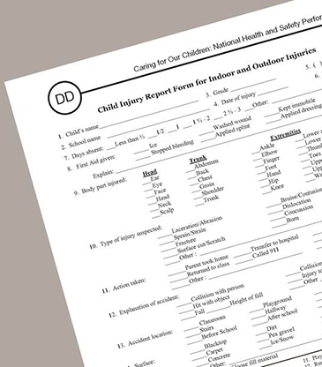
Documentation Requirements
Complete 3 copies of injury report form
Parent/Guardian
Child’s folder at the Center
Injury log book
Keep based on state regulations
Send copy to state licensing agency if medical attention required
Notes:
Three copies of the injury report form should be completed
Parent/Guardian
Child’s folder at the Center
Injury Log Book
This should be chronologically filed that is analyzed periodically to determine any patterns regarding time of day of the incident, equipment involved, location of the incident, and supervision at the time of the incident.
The copy should be kept for the period required by state regulations
A copy of the injury report should be sent to the state licensing agency if it required medical attention
CFOC Standard 9.4.1.9 Records of Injury and CFOC Standard 9.4.1.10 Documentation of Parent/Guardian Notification of Injury, Illness, or Death in Program) – Appendices CC and DD (http://cfoc.nrckids.org/WebFiles/CFOC3_updated_final.pdf)

Slide 49
Corrective Action
The center should take action based on logs
Adjusting schedules
Removing or limiting use of equipment
Relocating equipment or furnishings
Increasing supervision
Review forms regularly for injury trends/patterns
Notes:
Based on the injury logs, the early care and education center should plan to take corrective action. This would include:
Adjusting schedules
Removing or limiting use of equipment
Relocating equipment or furnishings
Increasing supervision
Review these forms regularly for injury trends and patterns
Source
CFOC Standard 9.4.1.9 - Records of Injury. (http://cfoc.nrckids.org/StandardView.cfm?StdNum=9.4.1.9&=+)

Slide 50
Partnering with the Community
Community Resources for child safety information
Safe Kids Worldwide (www.safekids.org)
National/Local organizations
Offers classes and events
Healthy Children (www.healthychildren.org)
Educational articles and videos
Supported by the AAP
Notes:
It is important to know your community resources that you can reach out to and partner with on child safety issues. There are educational materials, classes, and events that are available in most communities.

Slide 51
Post Quiz
What is the most common injury among children age 0-5?
Broken bones
Falls
Choking
burns
Notes:
At the beginning of the presentation, 5 questions were posed that you were asked to think about during the talk. We will now revisit these questions, answer them, and discuss them. Please refer to the standards in Caring for Our Children for more information.
Source
Caring for Our Children Standards. (http://cfoc.nrckids.org/)

Slide 52
Post Quiz
What is the most common injury among children age 0-5?
Broken bones
Falls
Choking
burns
Notes:
Falls are the most common injury among this age group. As we learned, more than 50% of the injuries among children less than 1 year old are from falls; and just under half of children ages 1-4 suffer the most injuries from falls.

Slide 53
Post Quiz
What is the most common preventable cause of death for children ages 1-4?
Burns
Choking
Drowning
Bicycle accidents
Getting hit by a car

Slide 54
Post Quiz
What is the most common preventable cause of death for children ages 1-4?
Burns
Choking
Drowning
Bicycle accidents
Getting hit by a car
Notes:
Drowning is the most common preventable cause of death for this age group, and swimming pools are the most common place where these drownings occur.

Slide 55
Post Quiz
Is there a requirement to report injuries?
Yes
No

Slide 56
Post Quiz
Is there a requirement to report injuries?
Yes
No
Notes:
We just discussed the documentation and reporting requirements for injuries that occur in the early care and education setting.

Slide 57
Post Quiz
Where do the majority of infant drowning deaths occur?
Pools
Ponds/Lakes
Falling off a boat
Bathtubs/Buckets

Slide 58
Post Quiz
Where do the majority of infant drowning deaths occur?
Pools
Ponds/Lakes
Falling off a boat
Bathtubs/Buckets
Notes:
Drowning in a bathtub or large bucket is the number one place where the majority of infant drownings occur. It is vital that when infants are in the bathtub that they are supervised at all times and the adult supervising the infant does not turn away, even for a second.

Slide 59
Post Quiz
What object is associated with the highest rate of death from choking?
Grapes
Hotdogs
Latex Balloons
Marbles
Coins

Slide 60
Post Quiz
What object is associated with the highest rate of death from choking?
Grapes
Hotdogs
Latex Balloons
Marbles
Coins
Notes:
Latex balloons pose the biggest threat for death by choking. The balloon can get lodged in the throat and create a seal that completely blocks the airway.

Slide 61
SAFETY AND INJURY PREVENTION TOPIC HIGHLIGHTS
Notes:
The next portion of this presentation will highlight 5 key areas where safety and injury prevention are important, especially in the early care and education setting. The key points from each of the following areas will be presented. If you want more in-depth information about any of these topics, download the specific module from the Healthy Futures Web site.
Medication Safety and Poison Prevention
Playground Safety
Helmet Safety
Transportation Safety
Burn and Fire Prevention

Slide 62
Insert slides from the other 5 modules here
Medication Safety and Poison Prevention
Playground Safety
Helmet Safety
Transportation Safety
Burn/Fire Prevention
Notes:
Source:

Slide 63
Resources
Safe Kids Worldwide – www.safekids.org
Healthy Children – www.healthychildren.org
Centers for Disease Control and Prevention
www.cdc.gov/safechild

Slide 64
Acknowledgments
This curriculum has been developed by the American Academy of Pediatrics (AAP). The authors and contributors are expert authorities in the field of pediatrics.
The recommendations in this curriculum do not indicate an exclusive course of treatment or serve as a standard of medical care. Variations, taking into account individual circumstances, may be appropriate.
Listing of resources does not imply an endorsement by the AAP. The AAP is not responsible for the content of resources mentioned in this curriculum.
Website addresses are as current as possible but may change at any time.
Support for the Heathy Futures curricula has been provided through funding from Johnson & Johnson Consumer Inc.

Slide 65
Acknowledgments
Project Advisor
Andrew N. Hashikawa, MD, MS, FAAP –
AAP Early Childhood Champion (Michigan) University of Michigan Injury Center
(Assistant Professor)
Curriculum Content Consultant
Amy Teddy – Child Safety & Injury Prevention Expert (University of Michigan)
Steering Committee
Danette Glassy, MD, FAAP
AAP Council on Early Childhood Member
Nancy Topping-Tailby, MSW, LICSW
National Center on Early Childhood Health & Wellness
Susan Pollack, MD, FAAP
AAP Committee, Section, Council Reviewers
Council on Early Childhood
Council on Injury, Violence, and Poison Prevention
Disaster Preparedness Advisory Council

Slide 66
Copyright Information
Copyright©2016 American Academy of Pediatrics. All rights reserved. Specific permission is granted to duplicate this curriculum for distribution to child care providers for educational, noncommercial purposes.

