Slide 1
CCHC
Child Care Health Consultation for a Healthy Start in Child Care
CCHC

Slide 2
What is CCHC?
Child Care Health Consultation is a statewide program & part of the Kids Now Initiative
CCHC provides consultation & technical assistance to licensed child care centers & to certified family homes

Slide 3
The Goal of CCHC
To promote healthy, safe, nurturing environments for optimal child development

Slide 4
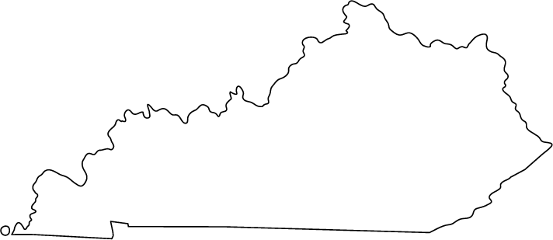
Technical Assistance & Training Center
The CCHC Technical Assistance & Training Center is located at the Lexington-Fayette County Health Department
It is staffed by 2 CCHC Technical Assistants/Trainers

Slide 5
Technical Assistance & Training Center
This center offers training, educational information, newsletters with health & safety information, health alerts, & other resources for consultants throughout the state to disseminate to their local child care centers

Slide 6
What is Technical Assistance?
Technical Assistance is assistance in implementing best practices & procedures in child care
Technical assistance includes consultation & hands-on training using a method of modeling behaviors or procedures & having the trainee demonstrate the modeled behavior or procedure for a desired outcome

Slide 7
What is Best Practice?
Best practices are the guidelines for conducting child care routines according to Caring for Our Children: National Health & Safety Performance Standards & other evidence based research publications
Caring for Our Children: National Health & Safety Performance Standards was created by the American Academy of Pediatrics, the American Public Health Association, & the National Resource Center for Health & Safety in Child Care

Slide 8
Technical Assistance & Training Center
The Technical Assistance & Training Center provides best practice examples of policies on health, safety, & nutrition for child care providers
The TA Center makes referrals to local resources in the community (First Steps, STARS, Early Childhood Mental Health Specialists)

Slide 9
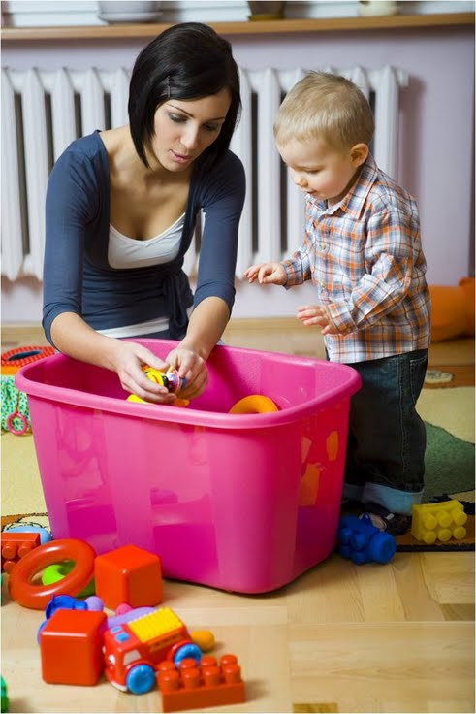
Consultants
Every Kentucky county has a consultant working to provide you information & technical assistance
The Child Care Health Consultants include Registered Nurses, Registered Dieticians, & Health Educators

Slide 10
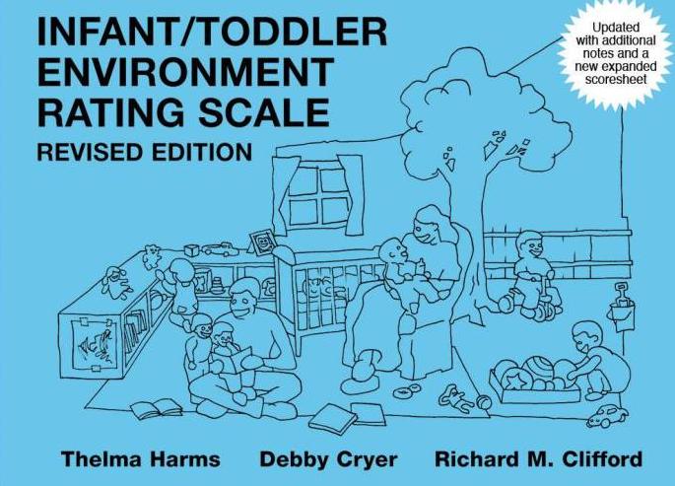
Consultants
Consultants rate child care centers using the Infant/Toddler Environment Rating Scale (ITERS-R) & the Early Childhood Environment Rating Scale (ECERS-R)
Consultants can work with the child care centers & family homes to improve ITERS-R & ECERS-R scores
ITERS-R
ECERS-R

Slide 11
Consultants
Consultants assist with preparation for STARS & licensing visits
Consultants can review the existing policies of a child care center & provide best practice policy examples

Slide 12
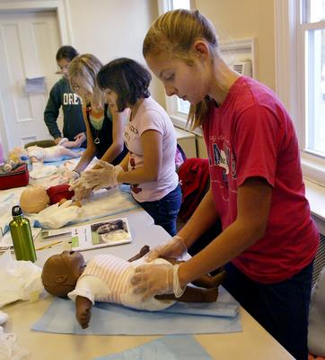
Consultants
Consultants can consult with you over the phone, through email, or at your site
Consultation topics include
Health
Safety
Nutrition
Social & emotional well being

Slide 13
Consultation & Technical Assistance Topics
Health
Consultants can provide health information & recommendations
Examples
Infectious disease
Exclusion policies
Hand washing
Diapering

Slide 14
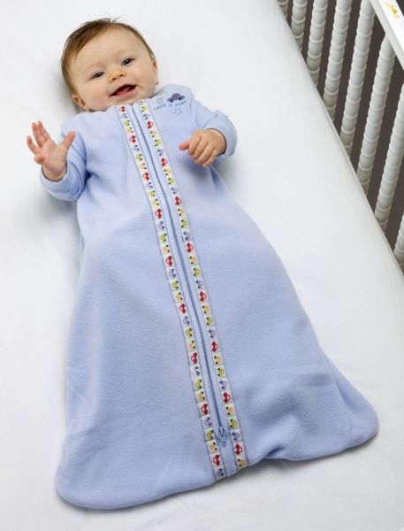
Consultation & Technical Assistance Topics
Safety
Consultants can provide safety information
Examples
Playground safety
Safe sleep
Car seat safety

Slide 15
Consultation & Technical Assistance Topics
Nutrition
Consultants can provide nutrition information & guidance
Examples
Food allergies
Meal programs

Slide 16
Consultation & Technical Assistance Topics
Social & emotional well being
Consultants can provide information regarding social & emotional well being
Example
Challenging behavior (i.e., biting)

Slide 17
CCHC Website
This public website allows consultants, child care providers, & parents to:
Download fact sheets of information
View FAQs about health & safety in child care
View examples of best practice policies for child care providers
www.kentuckycchc.org

Slide 18
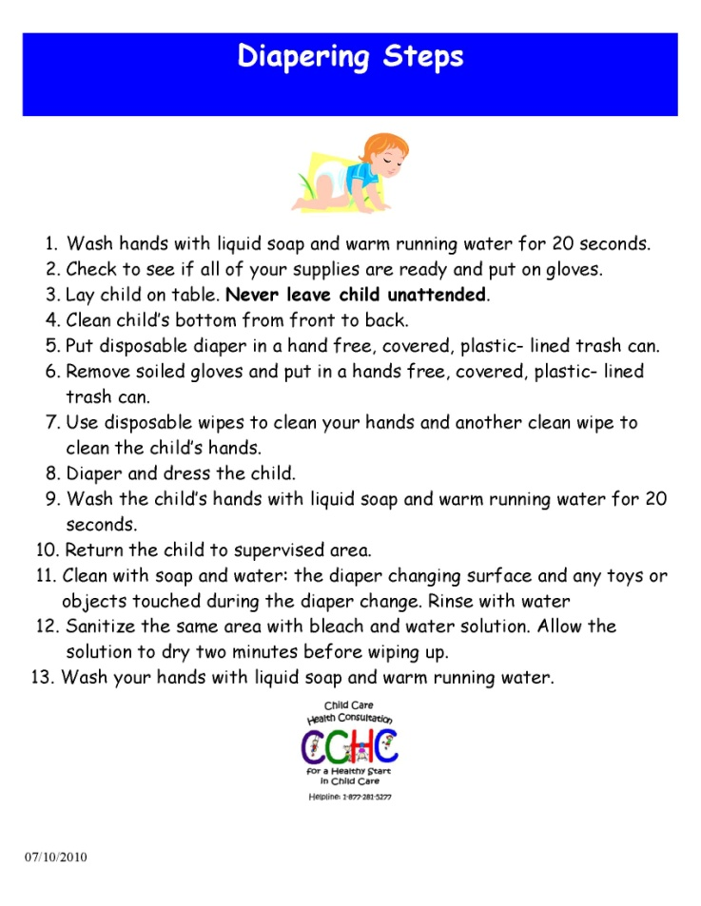
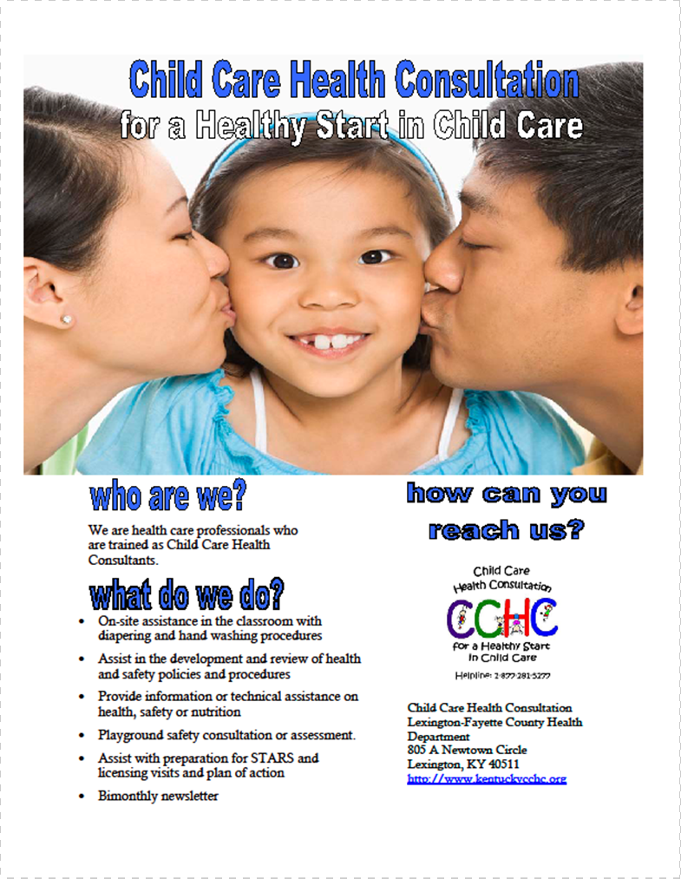
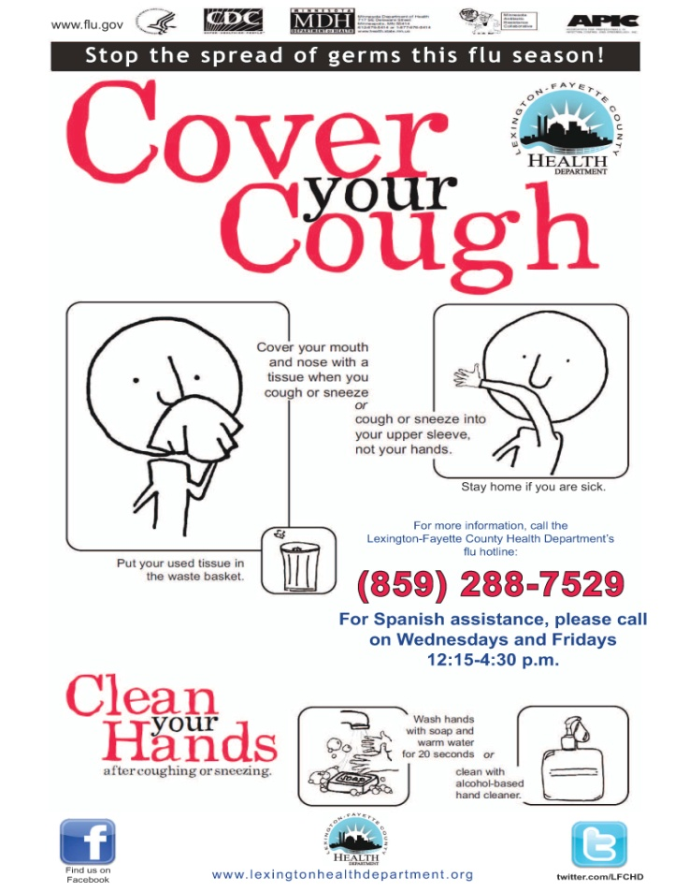
Sample documents from website

Slide 19
CCHC Helpline
The helpline:
Offers standardized health & safety information to child care providers
Facilitates referrals to local consultants & other child care agencies if needed
All child care centers in the state have this phone number
Call for your questions regarding health, safety, nutrition, and emotional well being
1-877-281-5277

Slide 20
CCHC

Slide 21
Post-test
What is CCHC?
What is the goal of CCHC?
Where is the Technical Assistant & Training Center located?
What is technical assistance?
What is best practice?
What are the professional backgrounds of the Child Care Health Consultants?
What are the four key consultation categories?
What are the three ways consultants can consult with you?
What are two services that consultants can provide?
What resources are available on the CCHC website?

