Slide 1
Typical Development, Red Flags, and Response to Trauma
Darcie Taggart, ATR-BC, LPAT, LPCC
Early Childhood Mental Health Specialist
Seven Counties Services, Inc.

Slide 2
Objectives
To learn typical developmental patterns for 3 and 4 year olds
To be able to identify red flags for behavior
To identify Trauma response and possible function of challenging behavior
To increase awareness of resources for children who are struggling

Slide 3
Basic Needs
All children, whether delayed or typical, have many psychological and physical needs..
These needs must be met if children are to survive, thrive, and develop to their potential.
Birth to 5 yrs of age is the most critical of any developmental periods across the lifespan.
The areas of development and developmental needs are interrelated and interdependent.
Ultimately if these needs are not being met there will be an impact on the overall development of the individual.

Slide 4
Basic Physical Needs
Shelter, protection from harm
Food – both nutritious and appropriate to the age of the child
Warmth, adequate clothing
Preventive health and dental care, treatment of illness and physical problems, cleanliness
Rest and activity, in balance (sleep)

Slide 5
Basic Psychological Needs
Affection and consistency
Security and trust
Appropriate adult expectations as to what the child can and cannot do at each level of development.
Need to Learn
Need for Respect

Slide 6
Need to Learn
Freedom to explore and experiment with necessary limits clearly stated and consistently maintained.
Access to developmentally appropriate experiences and play materials.
Errors, mistakes and failures treated as important steps in learning process.
Adults who demonstrate in everyday life the appropriate behaviors expected of the child, be it language, social interactions or ways of handling stress. Modeling is KEY!

Slide 7
Need for Respect
A respectful and helpful environment in which the child’s efforts (not just successes) are encouraged, approved and aided.
Appreciation of the child’s efforts, praise for their accomplishments, small and large.
Recognition of accomplishment is the major and essential component of child’s self-esteem.
Sincere attention to what the child is doing well, helping the child learn to respect their own accomplishments through descriptive praise.
Awareness of tremendous effort and concentration that goes into acquiring developmental skills.

Slide 8
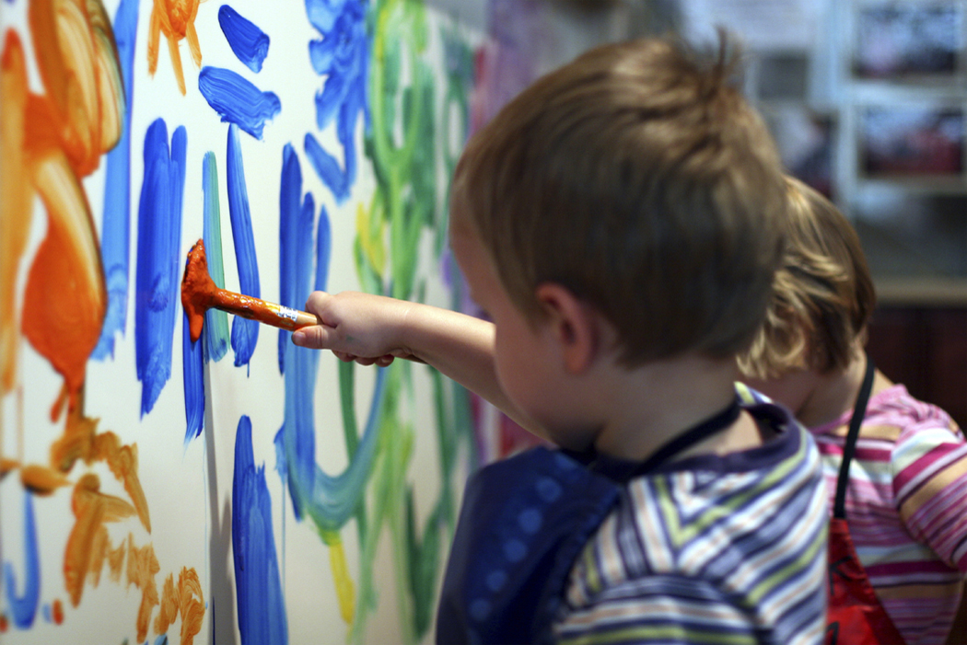
The
Preschool
Years

Slide 9
Development 3 years old
Motor Development (Gross)
Motor Development (Fine)
Can walk without watching feet
Climbs stairs with alternating feet
Jumps off low objects well but difficulty to judge jumping over objects
Improved coordination, can begin to ride a tricycle but may bump into things.
Can stand on one foot but not steady
Plays actively and needs rest. Can be cranky if overtired.
Kicks a ball
Bend over without falling down
Can fatigue easily if hand coordination is expected.
Make up and down, side to side, and circle lines
Turns book pages one at a time
Holds crayons or markers with fingers rather than fist
Undresses without assistance but may need help getting dressed
Can unbutton but buttoning can be an issue
Places large objects on a pegboard, string beads, pour liquid but with some spilling
Build block towers at least 6 tall
Can do puzzles with whole object represented as one piece

Slide 10
Development 3 years old
Language Development
Shows a steady increase in vocabulary, ranging from 1000 to 3000 words roughly
Use simple sentences of 3-4 words
Difficulty taking turns in conversation
Changes topics quickly
Can have difficulty pronouncing words
Likes finger plays and rhymes, can learn songs with repetition
Asks many who, what, when, where, why questions
Can tell a story but often has difficulty with sequencing a story
Can follow at least one to two step directions.
Beginning to understand placement in space, over, under, etc.
Can usually say name, age, and gender
Uses pronouns (I, we, me) and some plurals (cats, dogs)
Strangers can understand most of their words.

Slide 11
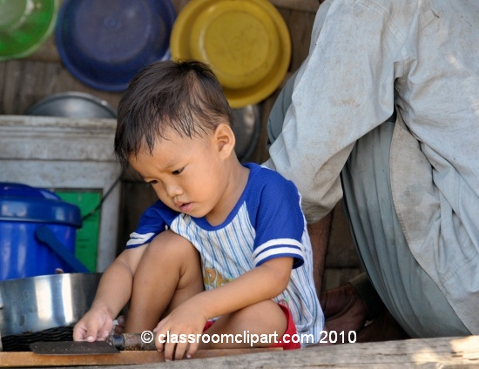
Development 3 years old
Cognitive Development
Makes mechanical toys work
Matches an object in his or her hand or room to a picture in a book
Plays make believe with dolls, animals, and people
Sorts objects by shape and color
Completes puzzles with three or four pieces (sometimes more)
Understand the concept of “two”
Can match two pictures together
Can point out pictures in a book when prompted
Can often memorize words to songs
Still learning to sequences events and the order of tasks

Slide 12
Development 3 years old
Social Emotional Development
May look on from the sidelines or engage in parallel play with peers until becoming more familiar with children
Difficulty taking turns and sharing
Usually needs help resolving problems with peers if they arise
Plays well with others when conditions are favorable in terms of materials, space, and supervision (but less likely to have prosocial behavior if these are lacking)
More cooperative than toddlers
Wants to please adults
Can follow simple requests (usually one step directions.
May wander off at times, likes to be treated like a “big kid” but still needs supervision
Expresses intense feelings
Silly sense of humor
Imitates adults and playmates
Can show affection towards playmates
May take turns in games
Understand the concept of mine and yours
Routines are very important and changes are often objected to
Should be able to separate easily from parent

Slide 13
3 years – Sleep
Should sleep 12 hours total per day
Many preschool children do not get adequate sleep and are tired and sleepy during their day. Afternoon naps may still be needed to get enough sleep in the day.
When children are not getting enough or restful sleep they may show signs of behavior disruption or other social and emotional concerns.

Slide 14
3 years – Red Flags
Can not throw a ball overhand
Can not jump in place
Can not ride a tricycle
Can not grasp a crayon between thumb and fingers or has difficulty scribbling
Can not stack 4 blocks
Still clings or cries when parent or other primary caregiver leave them
Shows no interest in interactive games or fantasy play
Ignores other children
Resists dressing, sleeping, using the bathroom
Lashes out without any self control when angry or upset
Can not copy a circle
Does not use sentences of more than three words
Excessively aggressive or withdrawn from other children
Play in repetitious or stereotyped ways
Not dry during the day (by 4) or starts wetting again
Unable to follow verbal directions
Speech is garbled or does not talk while playing at all.
What Caregivers Can Do
If red flags present themselves at this age it is time to seek outside resources to help with development if not done already

Slide 15
Development 4 years old
Motor Development (Gross)
Motor Development (Fine)
Walks heal to toe, skips unevenly, can run
Can stand on one foot for 5 seconds
Can kick a ball forward
Judges well where to put feet in climbing structure or playground
Can jump rope
Can coordinate movement to climb on jungle gym
Shows awareness of own limits and consequences of unsafe play but still needs supervision to cross streets and protection in some activities
Increased endurance and higher periods of energy
Can throw a ball overhand and catch a bounced ball most of the time
Builds complex block structures
Enjoys play objects with small parts
Likes to use scissors
Draw combination of simple shapes that an adult can recognize
Draws persons with at least four parts
May begin to copy capital letters
Can draw a circle and a square
Dress and undress without assistance

Slide 16
Development 4 Years Old
Language Development
Expands vocabulary from 3000 to 5000 words
Usually uses 5-6 word sentences
Can memorize many rhymes and finger plays
Likes to tell stories and family experiences but may be shy in front of groups
Can control volume of voice for a period of time if reminded
Begin to use more advance sentence structure when speaking
May try to communicate more than vocabulary allows and use other words to mean things
Learns new vocabulary quickly if it’s related to their own experience
Can retell a four or five step directive or sequence in a story
Speaks clearly so strangers can understand
Tells stories

Slide 17
Development 4 Years old
Cognitive Development
Can usually tell sequence of things though may need some help still putting stories in the right order
Recalls parts of the story
Begin to have objects represented in art with more accuracy
Correctly names some colors
Understands the concept of counting and may know a few numbers
Tries to solve problems from a single point of view
Begins to have a clearer sense of time
Follows three part commands
Understands the concept of “same” and “different”
Engages in fantasy play and uses lots of imagination
Imaginary friends may develop

Slide 18
Development 4 years old
Social-emotional Development
Expresses emotion through facial gestures and can begin to use body clues from others to judge emotion
Issues verbal commands to peers
Interested in new experiences
Cooperates and plays with other children in give and take fashion
Plays “Mom” and “Dad” a lot
Increasingly inventive in imagination play
Dresses and undresses
Negotiates solutions to conflicts, may be argumentative
More independent
May imagine unfamiliar objects are “monsters”
Views self as a whole person, body and mind and feelings
May have difficulty telling the difference between fantasy and reality
Can begin to use and understand feeling words
May have difficulty sharing but can take turns in play
Aggressive play may develop, easily angered
Spontaneously offers toys and items to others, wants to be friends
May know that self regulation is expected but still have a hard time doing that without assistance

Slide 19
4 Year Olds – Sleep
Sleep usually decreases to about 11.5 hours by age 5 and 11 hours by age 6.
Children often will give up naps by age 4 if not before and most Kindergarteners are fully capable of making it through an entire day without naps
Bedtime routines and protecting bedtime are very important at this age to get a child the sleep they need to grow, learn, and develop

Slide 20
4 Year Olds – Red Flags
Exhibits extremely fearful, timid, or aggressive behavior
Unable to separate from parents
Easily distracted and unable to concentrate on any single activity for more than 5 minutes (excluding TV)
Refuses to respond to people in general or only superficially
Does not use fantasy or imaginative play
Unhappy or sad most of the time
Engages in limited activities
Trouble eating, sleeping, or toileting
Lack of eye contact
Extreme sensitivity to touch, texture, loud noises, clothing or food
Unable to differentiate between reality and fantasy
Intentional harm to self or others
Can not understand two part commands
Can not correctly give first and last name
Inability to calm down in 15 minutes
Can not build a tower 6-8 blocks
Difficulty holding crayons
Trouble taking off clothes
Can not brush teeth efficiently
Not progressing in learning
Lack of or inability to sleep
Overly affectionate to strangers
Shows little interest in playing with others

Slide 21
Factors that affect development
Not meeting basic needs
Difficult or lack of attachment to caregivers
Abuse and Neglect
Nutrition
Lack of stimulation in the Environment
Physical Impairments or Disabilities
Birth trauma or early childhood trauma
Home environmental stressors
Emotional stress from the caregiver
History of multiple caregivers

Slide 22
Trauma and Brain Development

Slide 23
Bessel Vanderkolk, M.D.
“Exposure to violence increases cortisol production and secondarily decreases the number of synapses between the cortex and the limbic system.”

Slide 24
Neglect/Abuse Changes Brains
CIVITAS Child Trauma Programs
Brains are 20-30 % smaller
Romanian Orphans
Speech Delays
Hearing Problems
Gross and Fine Motor Problems
SOCIAL DEFICITS

Slide 25
Adverse Childhood Incidents
ACE’s STUDY
Research study of 17,000 participants.
Showed that ACE’s can affect an individual’s physical and emotional health throughout the life span not just at the time of the experience.
Determined that Trauma and traumatic experiences are far more prevalent than previously recognized.
Copyright 2012 Trauma Informed Care Stakeholders Group Training Subcommittee

Slide 26
Trauma Statistics
A report of child abuse is made every ten seconds in the United States. (Childhelp, 2013)
Children who experience child abuse and neglect are 59% more likely to be arrested as a juvenile, 28% more likely to be arrested as an adult, and 30% more likely to commit violent crime. (Child Welfare Information Gateway, 2006)
Trauma histories are pervasive among youth in America (especially youth from diverse cultural backgrounds). (Marcenich, 2009)
Children with disabilities are more likely to experience neglect than children without disabilities. (Child Welfare Information Gateway, 2006)
Copyright 2012 Trauma Informed Care Stakeholders Group Training Subcommittee

Slide 27
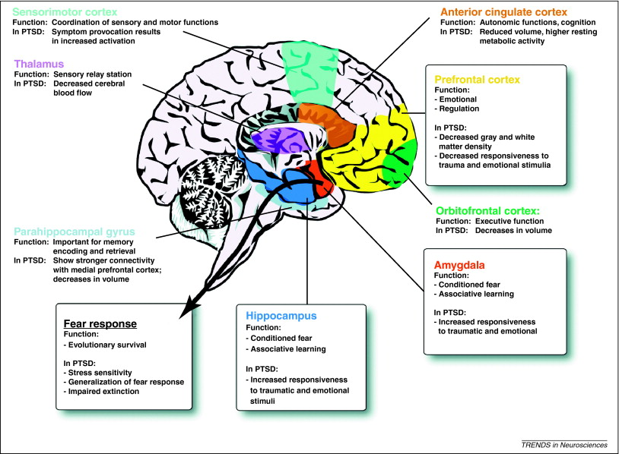

Slide 28
Effects of Trauma
Activation of survival responses:
Fight
Flight
Freeze
Shutting down of non-essential tasks (which can include school and listening to adults).
Rational thought is less possible at this time.
(Hopper, 2009)

Slide 29
Additional Effects of Trauma
Prolonged exposure to trauma and/or repetitive traumatic events MAY:
Cause an individual’s natural alarm system to no longer function as it should.
Create emotional and physical responses to stress.
Result in emotional numbing and psychological avoidance.
Affect an individual’s sense of safety.
Diminish an individual’s capacity to trust others
(Hopper, 2009)

Slide 30
More Effects of Trauma
The following responses to trauma/traumatic events are components of Posttraumatic Stress Disorder (PTSD):
Hyperarousal: nervousness, jumpiness, quickness to startle.
Re-experiencing: intrusive images, sensations, dreams, memories
Avoidance and Withdrawal:
feeling numb, shutdown or separated from normal life
pulling away from relationships and/or activities
avoiding things that trigger memories of trauma/s

Slide 31
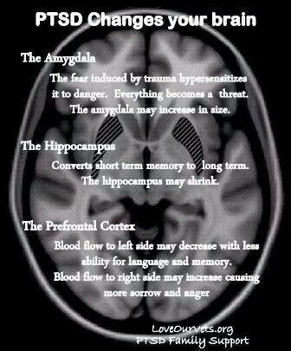
Trauma causes permanent damage to the brain as it changes the connections that are made and the biological process of response to external stimulation.

Slide 32
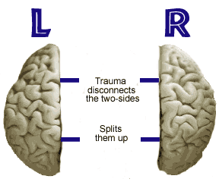

Slide 33
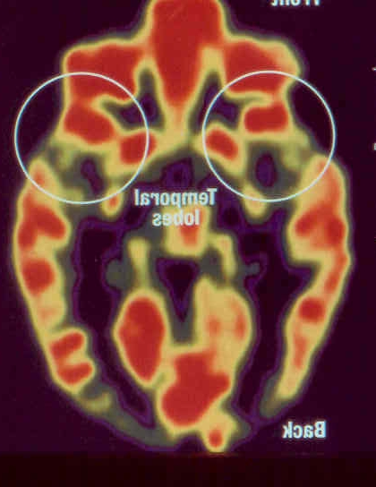
Normal Brain

Slide 34
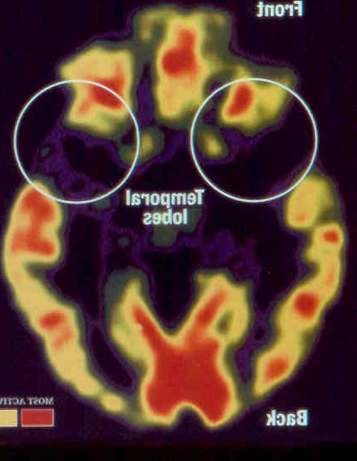
Brain of Child
that was severely neglected in the first three years of life

Slide 35
Synaptic Connections in Brain
The brain is over wired. There are more options for connection than we will ever need or use.
Pruning – New synapses form as the result of stimulation; however others weaken or remain the same. Weaker cells dies off and are lost forever.
Connections get made because of experiences, once a path is formed it is harder for it to change.
Pruning is what causes those roads to form into “highways” in the brain.
Trauma reduces the number of appropriate response connections in the neural pathways.

Slide 36
Challenging behavior the result
Often due to the effects of Trauma and insufficient attachment these children come into classrooms with significant challenging behaviors as they attempt to calm down their disregulated nervous system.

Slide 37
“Of the young children who show early signs of problem behavior it has been estimated that fewer than 10% receive services for these difficulties.”
(Kazdin & Kendall, 1998)
Center for Evidence Based Practice: Young Children with Challenging Behavior www.challengingbehavior.org

Slide 38
Mental Health use in Children
12-17 yrs
5-12
0-5
-50%
-40%
-10%

Slide 39
“Early appearing aggressive behaviors are the best predictor of juvenile gang membership
and violence.”
(Reid, 1993)
Center for Evidence Based Practice: Young Children with Challenging Behavior www.challengingbehavior.org

Slide 40
“When aggressive and antisocial behavior has persisted to age 9 further intervention has a poor chance of success.”
(Dodge, 1993)
Center for Evidence Based Practice: Young Children with Challenging Behavior www.challengingbehavior.org

Slide 41
There are evidence-based practices that are effective in changing this developmental trajectory.
The problem is not what to do, but rests in ensuring and promoting access to intervention and support.
Center for Evidence Based Practice: Young Children with Challenging Behavior www.challengingbehavior.org

Slide 42
Resources
The basics of dealing with challenging behaviors that are presented and resources for referring children and families to ongoing services when needed.

Slide 43
Estimated Prevalence
Between 4-10% of all young children have clinically significant emotionally and behavioral challenges. (Center for Mental Health in Schools, 2005).
Children from low income families are more likely to develop behavior problems with prevalence rates approaching 30%. (QI & Kaiser, 2003)
Children from single parent homes are more likely to be represented.
Prevalence is likely to be underestimated due to lack of trained pediatricians in the areas of psychopathology and child development.

Slide 44
Statistics in Kentucky
Average age of child referred for treatment is 4.1 years
76% of referrals are male
44% referred by caregiver, 15% by school, and 12% by other mental health providers
28% of children under the age of 6 live in poverty
24% of KY children have special health care needs
10% of children struggle with asthma & KY has the highest rate of asthma attacks

Slide 45
Reasons for Challenging Behavior
A child could be:
Communicating a message when they do not have language
Using the behavior instead of language because they have limited social skills or have learned that challenging behavior will result in meeting his or her needs
At a developmental stage where they needs to test limits
Adjusting to an unfamiliar schedule
Confused by classroom expectations that differ from those at home
Upset by a family situation
Have experienced a Traumatic Event
Be bored, tired, curious, or frustrated

Slide 46
Responses to Challenging Behavior
Ignore inappropriate behavior when possible
Re-direct to a new activity
Design an Individualized Reminder System
Scaffold children’s learning and play
“Take a break” or use a form of time out
Natural consequences
Support Social/Emotional Competence
Refer for appropriate mental health services for the child and family

Slide 47
Social/Emotional Competence
Support Social/Emotional Competence:
Use effective praise (labeled versus unlabeled)
Describe and interpret feelings (what you think you see)
Model appropriate responses to situations/feelings
Teach social skills (scaffolding and problem solving)
Teach feeling states
Role-play, rehearse, and prompt social skills
Floor time (get down and play!)
Problem Solving time
Identify and Empathize with a Child’s point of View
Set firm, compassionate, and consistent Limits
Break a Challenge into Smaller Pieces

Slide 48
Three important things
Always: be bigger, stronger, wiser, and kinder
Whenever possible: follow the child’s need.
Whenever necessary: take charge using firm and consistent limits.

Slide 49
Remember
Be firm and consistent
Stay calm
Watch your non-verbal cues
Use a quiet and calm voice
Offer comfort and empathy
Offer affective attunement
Be firm yet nurturing
Seek support when necessary

Slide 50
Resources for Families
Early Childhood Mental Health (ECMH) Specialist - Provides free consultation and education services to families and early care and education staff that serve children age birth to five. Work closely with other local Early Childhood Resources that serve children birth to five and their families to provide mental health consultation, assessment, and therapeutic treatment services on behalf children age birth to five identified by those programs as needing mental health services or social and emotional delays.
Contact Person: Darcie Taggart
DTaggart@sevencounties.org
Contact Number: 502-589-8731

Slide 51
Resources for Families
Childhood Developmental Screenings with Concerns or Not (1 month up to 5 ½years old)
Metro United Way Success By 6
502.583.2821 or 2-1-1
1. MUW will mail an ASQ Questionnaire.
2. Complete the Questionnaire with your child and mail it
back.
3. MUW will send results right away! You'll also get a FREE BOOK, helpful tips, fun activities and connections to resources.

Slide 52
Resources for Families
Seven Counties Services
Provides crisis stabilization, Acute, clinic based, and in home therapeutic services for children and families. Mental Health services are designed to help strengthen families and encourage them to be their best selves. Using evidenced based practices therapists work with families as a whole to increase positive strengths based skills. We serve all families with Medicaid and several different insurances.
Specific Programs Include:
Acute Child Psychiatric – 589-8070
CCC Grant In Home Services
Clinic Outpatient Services – Access 589-1100
School Based Services (in various schools across the city)

Slide 53
References used
www.dimensionsfoundation.org/media/Developmental_Milestones_3to5.pdf
www.education.com/topic/child_developmental-milestones/
www.classroomclipart.com
Parents at Teachers National Center, Inc Handouts
Consultation with Christy Leaver and Stephanie Adamkin, specialists for Early Childhood Mental Health.

Slide 54
Thank you!
Contact:
Darcie Taggart, ATR-BC, LPAT, LPCC
Early Childhood Mental Health Program
914 E. Broadway, 2nd Floor
Louisville, KY 40204
502-589-8731, x2009
dtaggart@sevencounties.org

